Slide 1
Is Private School worth the cost?
Jack Cienkus and Kathryn Tumavitch
CMSE 381 – Section 002

Slide 2
Defining the Dataset and Question
We used "Student Academic Performance Dataset" by ayeshasiddiqa123
Information on 6,607 students
Dataset was cleaned by removing rows with NA values leaving 6,378 students
Hours Studied, Parental Involvement, Access to Resources, Extracurricular Activities, Sleep Hours, Previous Scores, Motivation Level, Internet Access, Tutoring Sessions, Family Income, Teacher Quality, School Type, Peer Influence, Physical Activity, Learning Disabilities, Parental Education, Level, Distance From Home, Gender, and Exam Score
Uses Exam Score as metric to determine worth of school type
Easy to quantify and a simple metric for student performance
Can we predict school type based on exam score? Is school type within the top three most influential factors for predicting exam score?

Slide 3
The Models – Classification and Regression
Classifying School Type based on Exam Score
Predicting Exam Score based on all other features
Logistic Regression
80/20 train test split
1000 iterations max
Random forest
80/20 train test split
100 estimators
Linear Regression
80/20 train test split
Forward Backward Selection
Random Forest
Post train pruning
K-fold CV

Slide 4
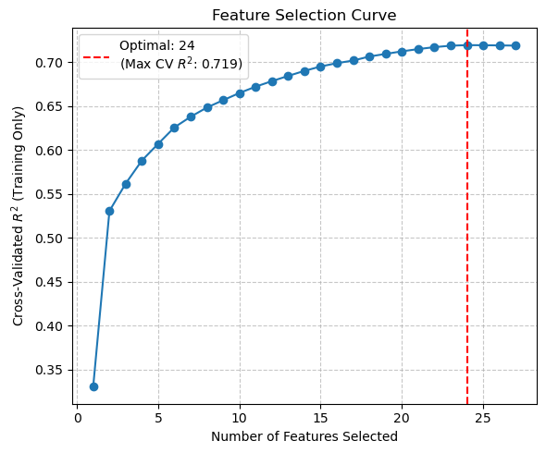
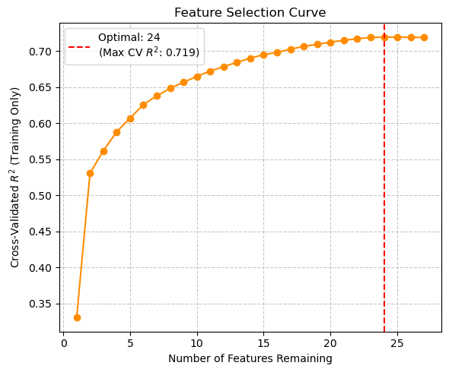
Computational Techniques – Forward/Backward Selection
Forward Selection
Backward Selection

Slide 5
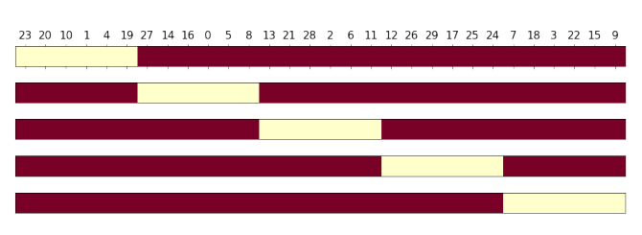
Computational Techniques – K-Fold CV
Split data 5 different times
Train and test the model for each split
Calculate the average R^2 and RMSE Score
Sourced from: Lecture 13 Slides

Slide 6
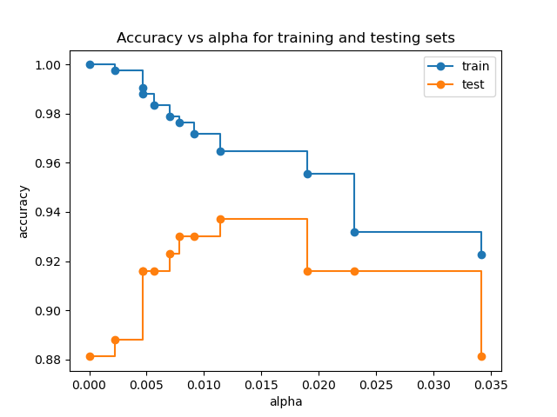
Computational Techniques – Sklearn Post-Train Pruning Techniques
Train the model with max amount of nodes
Prune node, train model again and calculate test error
After pruning all but one node, choose model with lowest test error
ccp_alpha value corresponds to how many nodes were pruned (the higher the ccp_alpha, the more nodes were pruned)
Sourced from: scikit-learn.org

Slide 7
Results
Conclusion:
We determined that it is not possible to determine school type from exam score
The logistic regression gave an accuracy score of 0.496
Random Forest gave a result of 0.4875
We also determined that consistently across models school type is not within the top three predictors of exam score
Linear regression: Access to recourses - low, Parental involvement - low, Family income -low
Pruned random forest: Attendance, hours studied, and previous scores
Same for unpruned
This leads us to believe that based on exam score private school is not worth it’s cost
Further Testing:
Further investigation of the worth of the worth of private school could involve looking into access to extracurriculars, teacher quality, and peer influence
Bigger dataset with more observations

